Slide 2
THEOLOGICAL VITALITY
Implications of the
Canadian Bible Engagement Study

Slide 3
Notes:
As presented by Jeromey Martini

Slide 4
Notes:
As presented by Jeromey Martini

Slide 5
Notes:
As presented by Jeromey Martini

Slide 6
Notes:
As presented by Jeromey Martini

Slide 7
Notes:
As presented by Jeromey Martini

Slide 9
Implications
Dave Wells: “When a large number of Canadians have a belief system that affirms diametrically opposed religious views and fuses together Jesus, the multiple gods of Hinduism, Western individualism and materialism, and the non-deistic understandings of Buddhism, we know we have a challenge on our hands.”
THEOLOGICAL VITALITY
Notes:
As presented by Will Sloos

Slide 10
Implications
Seeking a truth-based thirst for God
THEOLOGICAL VITALITY
Notes:
As presented by Will Sloos

Slide 11
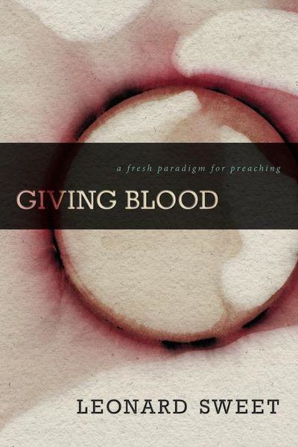
Notes:
As presented by Will Sloos

Slide 12
Implications
Leonard Sweet, Giving Blood: A fresh paradigm for preaching
“The sound of great preaching is not applause, but the creaking of doors in heaven and hell, and sometimes even in the back of the church.” (11)
THEOLOGICAL VITALITY
Notes:
As presented by Will Sloos

Slide 13
Implications
Sweet continues, “My preacher mom defined a bad sermon as one with no blood on the pulpit. ‘There’s no blood on the pulpit this morning,’ she would mutter to herself, sometimes in the midst of the sermon being delivered.” (16)
To give blood from the pulpit, preachers must bleed the Scriptures when you cut them – “and their bloodletting is healing…and a balm to the soul.” (25)
THEOLOGICAL VITALITY
Notes:
As presented by Will Sloos

Slide 14
Implications
Image exegesis seeks to exegete the metaphorical narrative of Scripture, not the words. This is consistent with the Hebrew art of Scriptural exegesis, and with Jesus’ method of teaching in parables.
Preaching should be EPIC (experiential, participatory, image-rich, connective). EPIC preaching is like field preaching. It allows everyone on the mission field.
Preaching should be transincarnational – facilitating a conversion experience in which people connect personally with Jesus Christ and undergo an incarnational change in mind, body, and spirit (preaching is not about the preacher).
THEOLOGICAL VITALITY
Notes:
As presented by Will Sloos

Slide 15
Bible Engagement in Canada
“Being an expert is a severe impediment to listening and learning.”
– Adam Kahane, Solving Tough Problems
THEOLOGICAL VITALITY
Notes:
As presented by Brandon Malo

Slide 16
Bible Engagement in Canada
What place does Scripture have in
my sermon preparation?
THEOLOGICAL VITALITY
Notes:
As presented by Brandon Malo

Slide 17
Bible Engagement in Canada
What place does Scripture have in
my sermon preparation?
How much of the Bible do I explore
through my preaching?
THEOLOGICAL VITALITY
Notes:
As presented by Brandon Malo

Slide 18
Bible Engagement in Canada
Outside of preaching, how often is
Scripture read or recited in a
worship service at my church?
As presented by Brandon Malo
THEOLOGICAL VITALITY
Notes:
As presented by Brandon Malo

Slide 19
Bible Engagement in Canada
Outside of preaching, how often is
Scripture read or recited in a
worship service at my church?
In what ways am I encouraging my
congregation to read the Bible?
THEOLOGICAL VITALITY
Notes:
As presented by Brandon Malo

Slide 20
THEOLOGICAL VITALITY
Notes:
As presented by Brandon Malo

Slide 21
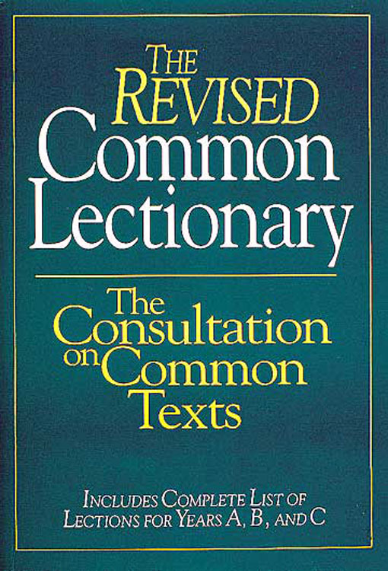
THEOLOGICAL VITALITY
Notes:
As presented by Brandon Malo

Slide 22
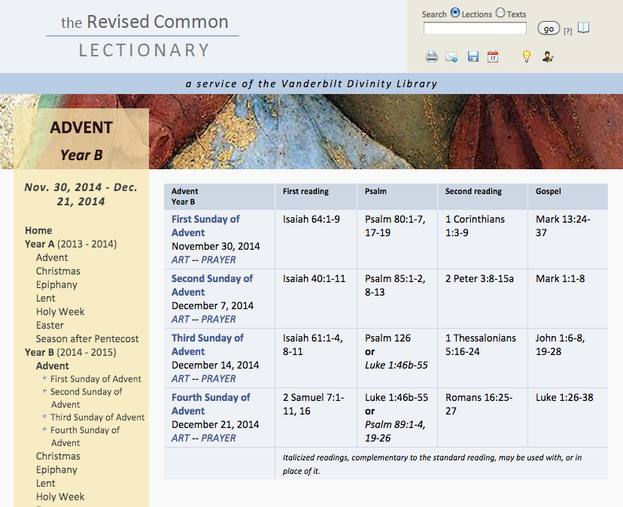
THEOLOGICAL VITALITY
Notes:
As presented by Brandon Malo

Slide 23
Bible Engagement in Canada
Why Are We Using the Lectionary?
Emphasize the place of Scripture
Notes:
As presented by Brandon Malo

Slide 24
Bible Engagement in Canada
Why Are We Using the Lectionary?
Emphasize the place of Scripture
Explore the whole of Scripture
Notes:
As presented by Brandon Malo

Slide 25
Bible Engagement in Canada
Why Are We Using the Lectionary?
Emphasize the place of Scripture
Explore the whole of Scripture
Encourage preparation
Notes:
As presented by Brandon Malo

Slide 26
Bible Engagement in Canada
Why Are We Using the Lectionary?
Emphasize the place of Scripture
Explore the whole of Scripture
Encourage preparation
Enable continuity across all ages
Notes:
As presented by Brandon Malo

Slide 27
Bible Engagement in Canada
Why Are We Using the Lectionary?
Emphasize the place of Scripture
Explore the whole of Scripture
Encourage preparation
Enable continuity across all ages
Demonstrate our unity
Notes:
As presented by Brandon Malo

Slide 28
Bible Engagement in Canada
Start with small changes:
public readings
observe seasons
THEOLOGICAL VITALITY
Notes:
As presented by Brandon Malo

Slide 29
Bible Engagement in Canada
Start with small changes:
public readings
observe seasons
The medium is the message
THEOLOGICAL VITALITY
Notes:
As presented by Brandon Malo

Slide 30
…discussions…
confidence, conversation, and community
Bible Engagement in Canada, 2013
confidence, conversation, and community
Bible Engagement in Canada
Notes:
As presented by Brandon Malo and Will Sloos

Slide 31
Are these statistics
surprising?
worrisome?
irrelevant?
useful?
Notes:
As presented by Brandon Malo and Will Sloos

Slide 32
Do you see evidence in your church of what this survey is reporting, that “the Bible is not directly shaping much of the church in Canada”? In what ways?
Notes:
As presented by Brandon Malo and Will Sloos

Slide 33
Are you - or how are you:
a) helping people process what we believe about the Bible? (as in inerrancy, inspiration, unity, uniqueness, etc.) b) helping people interact with the Bible? (understanding the texts of Scripture…application of texts)
c) helping people talk with other people about the Bible?
d) helping people remove the dullness/ routine of devotions/ Bible reading/ family devotions?
Notes:
As presented by Brandon Malo and Will Sloos

Slide 34
What might you be willing to try in your church to reverse this disturbing trend and see more engagement with the Bible?
Notes:
As presented by Brandon Malo and Will Sloos

Slide 35
Survey Said!
Use hand-out provided for local congregational use

Slide 36
How often do you read your Bible for personal devotion?
30 minutes or more per day
10-30 minutes per day
A couple times a week
Less than once a week
Has your practice of reading the Bible changed over time?
Yes, I am more engaged and committed than I have ever been
No, I am just as engaged as committed as I have been in the past
No, I continue to struggle with reading the Bible as I have in the past
Yes, I find myself less engaged and less committed than I have ever been

Slide 37
How would you describe your personal interaction with Scripture?
The Spirit continues to speak to me through scripture and God’s Word continues to impact the way I think and live
I am committed to engaging with Scripture regularly, but it has lost some of its vitality
I try to read it faithfully, but can go days without even thinking about it
The Bible has lost its luster on me; I rarely read it
How important do you think it is for you to read the Bible?
Absolutely essential, I can’t grow in life and faith without it
A good idea, but not absolutely necessary
It doesn’t really matter – I can learn enough from sermons and other resources

Slide 38
Do you feel challenged to read the Bible more?
Yes, I am regularly encouraged to make this a priority
Sometimes
No, I don’t feel like I am being challenged at all
How much of the Bible would you say you explore through your reading?
I make every effort to read from the whole of scripture and have a system that guides me to this end
I try to explore new passages and stories from time to time, but typically go back to familiar parts
I avoid parts of the Bible that aren’t as appealing or easy to understand

Slide 39
How frequently are commentaries or other similar resources used to increase the depth of your study, and in turn, your understanding of Scripture?
I use them as a regular part of my study and devotional time
I try to use them from time to time
I don’t usually use these kinds of resources
I never use these kinds of resources
Outside of preaching, how often is Scripture read or recited in a worship service at your church?
Every week
Once or twice a month
A few times a year
Very rarely/never

Slide 40
Would you like to hear the Scriptures read more consistently in public worship?
Yes, that would be a welcome change
No, the present amount is good
This isn’t something that matters to me
Are there opportunities for you to discuss the Bible together with other believers?
Yes, this is included as part of our regular Sunday morning gathering
Yes, there are small groups or classes that can be attended regularly
Not regularly, I occasionally participate in special classes or small groups
No, I do not

