Slide 1

REVITALIZATION AND MULTIPLICATION

Slide 2

2020 INITIATIVE
KEY PRIORITIES
Spiritual Vitality
Theological Vitality
Missional Vitality
To glorify God by making disciples everywhere by proclaiming and practising the gospel of Jesus Christ in the power of the Holy Spirit. [PAOC Mission Statement]

Slide 3
SPIRITUAL VITALITY
To experience spiritual vitality in an ongoing manner, we envision churches and leaders who:
Know intimacy with God through prayer and engagement with His Word
Are actively engaged in Spirit-empowered, Christ-honouring living
Demonstrate the necessity of Spirit-baptism and the adventure of living “naturally supernatural”
Mentor others in a Spirit-filled life.

Slide 4
THEOLOGICAL VITALITY
To be a people of theological vitality, we envision churches and leaders who:
Fulfil our mission to glorify God by making disciples who love God and others
Engage the Word of God in a living, active way
Know how to interpret the Scripture in a manner that is sound, both doctrinally and in lifestyle
Are liberated by the truth of God’s Word and are able to share those truths by example and speech in the contexts of their daily lives.

Slide 5
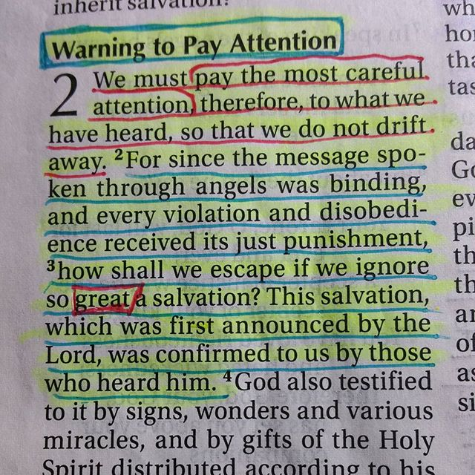
Hebrews 2:1-3

Slide 6
“Nexus” is intended to call us as Pentecostal people to evaluate those intersections where spirit, truth and mission meet in our lives and ministries. As worshippers who are spiritually and theologically vital, we desire to glorify Him with much fruit, fruit that will remain as evidenced in transformed lives.
~ David Wells
2015 PAOC Gift Book

Slide 7
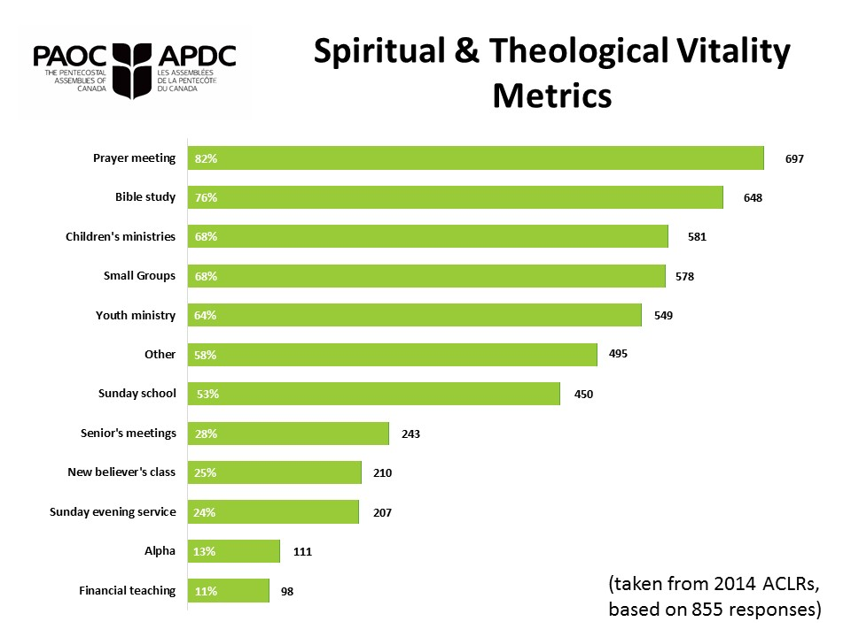

Slide 8
MISSIONAL VITALITY
For ongoing missional vitality, we envision churches and leaders who:
Personally engage in substantive relationships those who do not know Jesus.
Have local, regional, national and international expressions of mission occurring in their lives
See the multiplying DNA of the kingdom at work in their lives and churches
Passionately intercede for lost people
Generously give of their lives and resources
Notes:
Our focus in this Cross-Canada 2015.2016 tour is on Missional Vitality

Slide 9
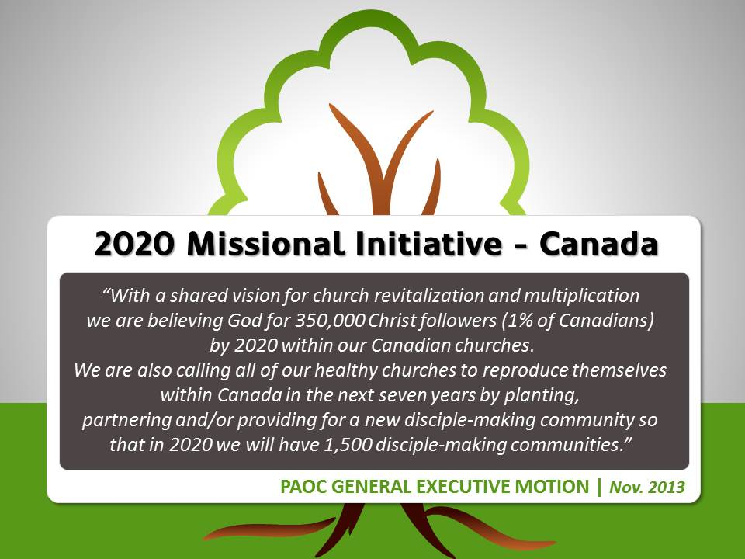
Notes:
Review of General Executive motion

Slide 10
REVITALIZATION

Slide 11

THE PRIORITY OF REVITALIZATION
GOAL: To see every PAOC church marked by
spiritual, theological and missional vitality by 2020
The best practices of a revitalization process include:
Holy Spirit – a prayerful, Spirit-led journey
Ownership by leadership – pastors and vision team involved (spouses often included)
Multiple sessions/retreats – allowing time for full engagement and opportunity for implementation
Evaluation, ongoing coaching and encouragement.

Slide 12

ACTION POINTS OF A
REVITALIZATION PROCESS
Establish or renew a motivating and guiding vision plan for the church
Clarify the values and priorities of the church
Put in place a strategic plan for the next 3 to 5 years for the church that addresses the biblical priorities of relationship, growth, service, evangelism, and worship
Equip leadership to share vision and identify other practical guides for their implementation.

Slide 13
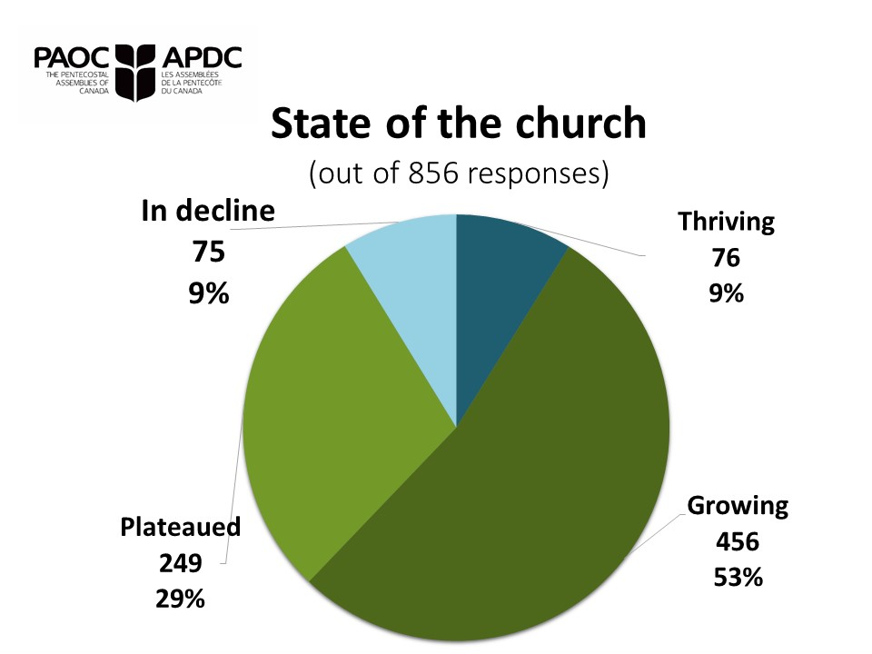

Slide 14
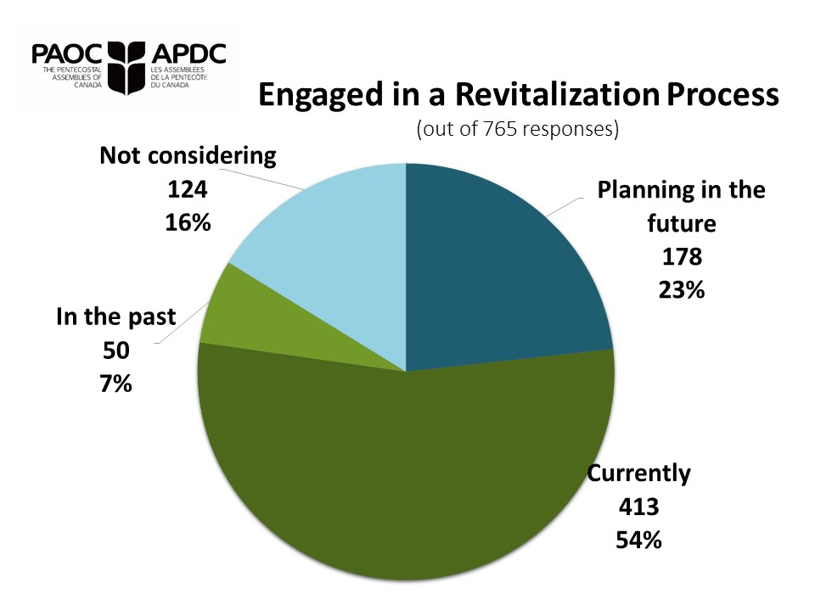

Slide 15

revitalization of a church over the years
Gary Taitinger
Senior Associate Pastor
Mill Woods Assembly
Edmonton, AB

Slide 16
revitalizing a suburban church in decline
Derrick Hamre
sharing on time at
Emmanuel Church
West Bank campus
West Kelowna, BC

Slide 17
revitalization in rural and small communities
Louis Halbgewachs
Lead Pastor
OneChurch.ca
Carlyle, SK

Slide 18
tenaciously pursuing the vision of a new day
Bob Jones, Lead Pastor
North Pointe
Community Church Edmonton, AB

Slide 19
PAOC FAMILY CONVERSATION
Appoint a group scribe to record your discussion including
key points, principles, recommended resources, etc.
1. Addressing plateau or decline
Identify principles and practices you heard when dealing with a church or ministry that is experiencing plateau or decline.
2. When the future is in question
Pragmatically, what strategies/initiatives/resources are you currently engaged in or interested in pursuing in order to ensure the ongoing vitality of your church or ministry?
3. Continual renewal of vision even when stable,
healthy or growing
Identify principles and practices you heard when you are maintaining a continual renewal of vision and vitality.

Slide 20
Why is it important to maintain an
internationally focused mission and vision
in the local church?
Four pastors share their thoughts…
REVITALIZATION

Slide 21
PAOC FAMILY CONVERSATION
Appoint a group scribe to record your discussion including
key points, principles, recommended resources, etc.
Do you feel it is important for the local church to have an international focus? Why or why not?
What obstacles or difficulties have you encountered when trying to encourage an international focus within your church?
3. What are some ideas that would help to overcome these obstacles/difficulties?

Slide 22
LUNCH CONVERSATIONS
Appoint a group scribe to record your discussion including
key points, principles, recommended resources, etc.
Gather at a designated table which pertains to the
present ministry setting you are in:
    Revitalizing your local church (Gary Taitinger)
    Revitalizing the suburban church (Derrick Hamre)
    Revitalizing in small/rural communities (Louis Halbgewachs)
    Reinvigorating existing/historic churches (Bob Jones)
    Strengthening the international focus (Darcy McAlister)
    Starting a new missional initiative (Karen Reed)
    Reaching cultural language groups (Charles Hermelink)

Slide 23
MULTIPLICATION

Slide 24
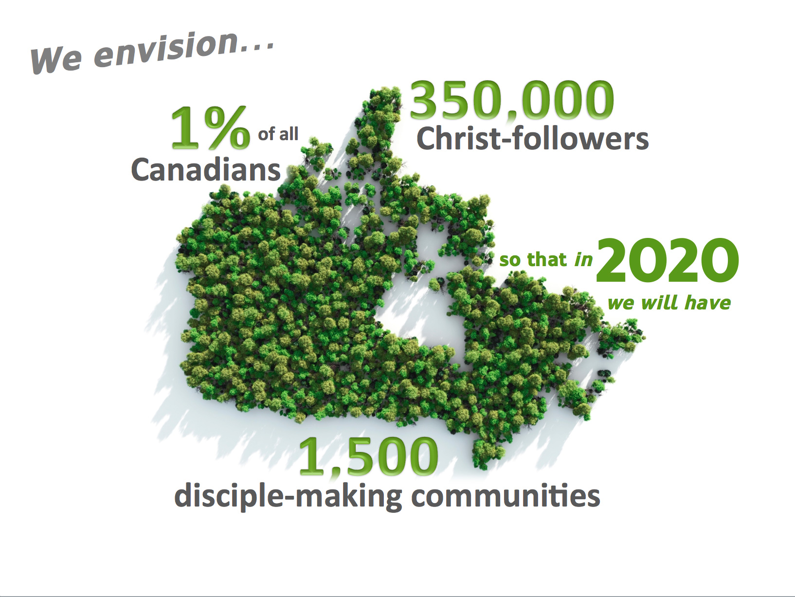

Slide 25

2020 INITIATIVE GOAL:
Every PAOC church to plant, partner and/or provide for the creation of a Disciple-making Community by 2020.
A Disciple-making Community is defined as:
“A Christ-centred gathering of people, with the support
of leadership, meeting regularly for worship, caring, teaching, praying, and actively engaging in mission
with the intention of continuing to meet
for these purposes indefinitely.”

Slide 26
PLANT
PARTNER
AND/OR
PROVIDE

Slide 27

PAOC Church Multiplication
Network: Mandate
Serve as a resource – provide awareness of resources available
Communicate best practices of church multiplication within the Canadian context to plant, partner and provide
Identify effective models
Encourage mentoring and networking

Slide 28
PAOC Church Multiplication Network: Mandate
Provide a venue for continual interaction between local, district and national contexts
Communicate in contexts such as General Conference, the annual gift book, colleges and districts regarding church multiplication
Be a catalyst to facilitate trans-local cooperation, affinity cohorts and effective engagement of the partner networks (City Reach, ARC, C2C)
Facilitate the ongoing development and use of the Church Multiplication Fund.

Slide 29
THE MISSIONAL VITALITY
OF OUR LEADERS
GOAL: That every leader would spend 52 significant periods of time annually personally engaged in substantive relationships with those who do not know Jesus.
What are “significant time periods”?
A day, morning, afternoon or evening committed to others outside of the church community.
52?
The equivalent of once per week, ensuring we are “beyond the walls”.

Slide 30
living slowly in the city being true to our personal mission in living out the “52”
Karen Reed
Mission Canada
Urban Worker
kreed@paoc.org

Slide 31
multiplication through partnership
New Hope church plant
North Pickering, ON

Slide 32
a local church committed to multi-site multiplication
Bill Markham
Lead Pastor
Central Community Church
St. Catharines, ON

Slide 33
initiating NNNetwork and identifying workers
Charles Hermelink
Mission Canada
Cultural Language Coordinator
chermelink@paoc.org

Slide 34
multiplication in “the uttermost”
Murray Cornelius
Assistant Superintendent
for International Missions
Brent Cantelon
PAOC Global Worker

Slide 35
PAOC FAMILY CONVERSATION
Appoint a group scribe to record your discussion including
key points, principles, recommended resources, etc.
In your setting, what are the opportunities and
obstacles to plant, partner and/or provide for a new disciple making community, and how are you engaging/addressing these?
What resources, partnerships would prove beneficial?
What lessons can we take from the majority world church that we can apply to our disciple making and church planting endeavours?

Slide 36
WHAT NEXT?
2016
2017
2018
2019
2020

Slide 37
Summary of Strategic Responses Expected of PAOC Ministries
Corporate prayer and Scripture engagement
Equipping for Spirit-empowered living
Incorporation of a revitalization process (especially where there are indicators of plateauing or decline)
Development of leaders for revitalization and multiplication
Participation in the formation of a new disciple-making community (plant, partner and/or provide)
Enhanced national and international mission engagement

Slide 38
Our church and ministry planters will
come from three primary sources:
Our Bible Colleges / Training Institutions
“Greenhouse” Churches
  those who are multiplying and developing leadership within
Entrepreneurial Leaders
  including those who come to Canada
  from other nations and ministries.

Slide 39

I.O. Projected Growth includes…
2018
2016
24 Workers
Comprehensive Strategy to Reach New Canadians
2020
Functioning Church Multiplication Network and Canadian STM
40 Workers and multiple missional channels and networks
2014
12 Workers
Reboot FLITE
Prayer Network
National Campus Summit

Slide 40
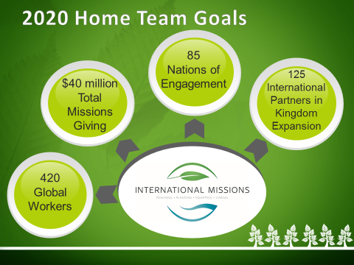

Slide 41
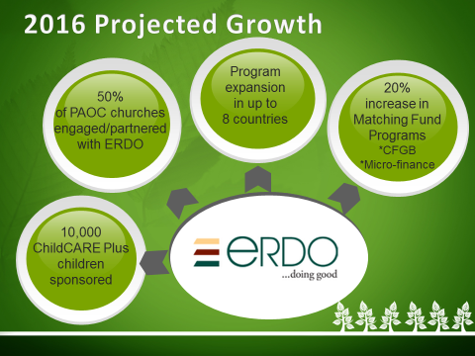

Slide 42
Moving FORWARD. . .
2016
2017
2018
2019
2020

Slide 43


