Slide 1
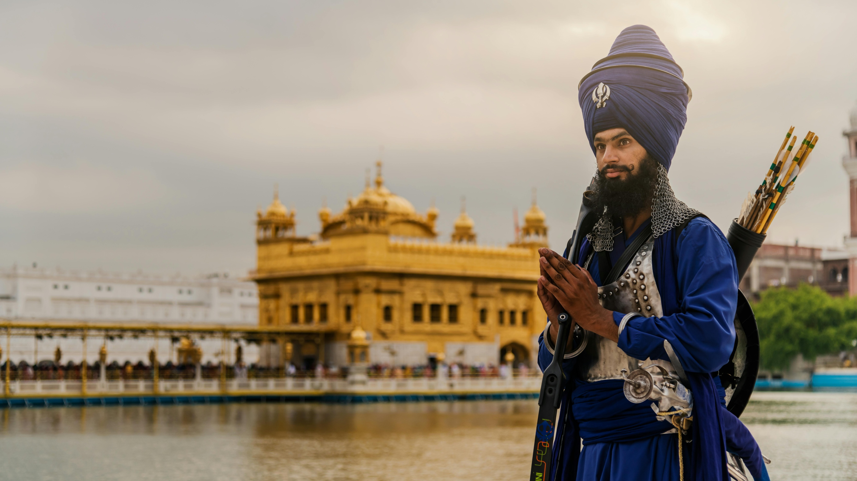


SIKHS
walking an
EMMAUS ROAD
journey with
SIKHS IN CANADA

Slide 2

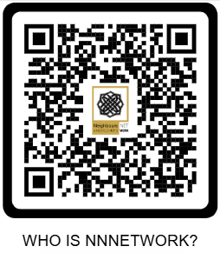
walking an EMMAUS ROAD journey with SIKHS in Canada©
has been produced by The PAOC’s Mission Canada Cultural Ministries Priority to highlight the need for befriending and reaching cross-culturally in our nation. It is produced with the profound agape’ love of Christ that motivates us to follow Jesus and be obedient to His command, “…you will be my witnesses in Jerusalem and in all Judea and Samaria, and to the end of the earth,” Acts 1:8 (ESV). And we’re motivated to take Emmaus Road journeys with those searching in the same way Jesus did in Luke 24, opening Scripture with compassion and grace explaining in all the Scriptures concerning Jesus so that their hearts burn within them!
© PAOC MISSION CANADA, ALL RIGHTS RESERVED. IMAGES: PEXELS.COM, VECTEEZY.COM, CHATGPT
Neighbours & Newcomers Network
is the ministry group within Mission Canada for those working in culturally sensitive areas wherein a protected online identity is advantageous not only for the worker but even more for those we are working with. Neighbours & Newcomers Network (NNNetwork) workers reach cross-culturally into the missional gaps in our nation of first-generation newcomers to Canada along with the following second and third generations. We deploy workers into the midst of our culturally diverse communities throughout Canada, reaching in religious groups who will otherwise not seek spiritual guidance from a local church. We seek to go be among, full of grace and truth, just like Jesus. Scan this QR code to learn more:

Slide 3
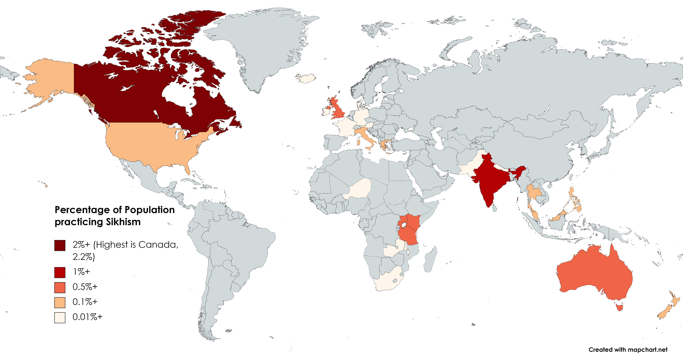
SIKHS
FAST FACTS
FOUNDING: Late 15th C. in Punjab, India, by Guru Nanak (1469-1539) who rejected caste and idol worship, emphasizing meditation on God’s name and honest living.
HOLY TEXT: Guru Granth Sahib, revered as living Guru, contains hymns from Sikh Gurus, Hindu, and Muslim saints.
THEOLOGY AND PRACTICE: Core beliefs include monotheism in one universal creator, the soul's cycle of rebirth broken by union with God through meditation, truthful living, equality of all people, and sharing earnings. Daily practices include the five “K’s,” prayer, meditation, bathing, etc.
WHERE THEY LIVE - Worldwide & Canada:
Sikhism's global population exceeds 25 million, primarily in Punjab, India, with significant diasporas: Canada has the largest population of Sikhs outside India with about 772,000 (2.1% of population per 2021 census), and is Canada’s fourth-largest religion. Key concentrations are: Brampton ON (163,000+), Surrey BC (154,000+), Calgary AB (49,000+), Edmonton AB (41,000+), with Ontario (300,000+) and BC (290,000+) leading provinces.

Slide 4





MAJOR BELIEFS
PRACTICES: THE 5 K’s
Sikhism originated in the late 15th century in Punjab, India, founded by Guru Nanak, and evolved through ten human Gurus until the eternal Guru Granth Sahib scripture took precedence. Its theology centers on one formless God (Ik Onkar), equality of all humans, and practices like the Five Ks and selfless service (seva). Guru Nanak rejected caste and idol worship, emphasizing meditation on God's name and honest living. Nine successive Gurus built the faith: Guru Angad standardized Gurmukhi script, Guru Arjan compiled the Adi Granth and built the Golden Temple, and Guru Gobind Singh (1675–1708) formed the Khalsa warrior order in 1699 while declaring the Guru Granth Sahib the eternal Guru.
Core beliefs include monotheism in a universal creator (Ik Onkar), the soul's cycle of rebirth broken by union with God through Naam Simran (meditation), truthful living, and sharing earnings. Equality rejects caste or gender hierarchies; all are seen as divine sparks. The Guru Granth Sahib, revered as living Guru, contains hymns of Sikh Gurus, Hindu, and Muslim saints.
For Sikhs who have taken Amrit (Khalsa initiation), the 5 Ks are sacred articles of faith that express identity, discipline, and readiness to live as “saint‑soldiers,” each pointing to specific spiritual and ethical values:
Kesh (uncut hair) - Represents acceptance of God’s will and respect for the body as God created it. And it symbolizes spirituality, dedication, and letting life be shaped by the Guru rather than by fashion or ego.
Kanga (wooden comb) - Stands for cleanliness, order, and self‑discipline. It reminds Sikhs to keep both body and mind “combed” and pure, not neglected or chaotic.
Kara (iron/steel bracelet) - A circular bangle symbolizing an unbroken bond with God, God’s eternity, and moral restraint. On the wrist, it continually reminds the wearer to use their hands only for righteous actions and to remain accountable to the Guru.
Kachera (special cotton undergarment) - Expresses modesty, sexual self‑control, and readiness for action. It reminds Sikhs of purity in thoughts and deeds and of living a morally disciplined life.
Kirpan (ceremonial sword/dagger) - A symbol of courage, dignity, and the duty to protect the weak and stand for justice. It combines “kirpa” (mercy) and “aan” (honor), pointing to the calling to be compassionate yet brave in defending others.
Taken together, the 5 Ks publicly identify a Sikh as Khalsa (the Sikh community) and signify a life devoted to God, moral purity, service, and readiness to defend truth and the oppressed.
© PAOC MISSION CANADA, ALL RIGHTS RESERVED

Slide 5

A COMPARISON OF THEOLOGY AND PRACTICES
ASPECT | SIKHISM | CHRISTIANITY
God | Ik Onkar (one formless creator), Waheguru (wonderous teacher) | Trinity (one being in three persons, Father Son & Holy Spirit)
Scripture | Guru Granth Sahib (eternal living Guru) | Holy Bible, inerrant in the original manuscripts
Salvation | Meditation on God, good deeds, grace | Faith alone in Jesus Christ, manifested in a life of submission
Initiation | Amrit Sanchar (keeping the 5 Ks) | Believer’s faith confession and water baptism
Worship | Kirtan, Langar at a Gurdwara | Personal and communal, sermons, singing, prayer, communion
Diet | Often vegetarian, no ritual slaughter of animals | No biblical restrictions
Service | Seva (selfless community service) | Charitable giving and serving others, missions, etc.
Equality | All equal, no castes or gender hierarchy | All are equal in Christ
MUKTI ~ SALVATION IN SIKH THOUGHT
​Definition of Salvation: Sikhism teaches that salvation, or mukti, is liberation from the cycle of birth and death (samsara), achieved through realizing one's unity with Waheguru (God). Mukti means release from bondage like ignorance, ego (haumai), illusion (maya), and suffering, leading to the fullest realization of the self as one with the divine. Unlike Christian salvation focused on sin's redemption, it emphasizes positive enlightenment and transcendence over negatives like guilt. It is jivan mukti (liberation while alive), attainable in this life, not just after death.
© PAOC MISSION CANADA, ALL RIGHTS RESERVED

Slide 6


Sikh Path to Obtain Mukti (Salvation):
Sikhs attain mukti via practicing the Three Pillars:
    Naam Japna (meditating on God's Name)
    Kirat Karni (honest living), and
    Vand Chakna (sharing with others).
KEY PRACTICES INCLUDE: Following Guru's teachings (Gurbani), selfless service (seva), conquering the five vices (lust, anger, greed, attachment, ego), and divine grace (nadar or hukam). Effort prepares the soul, but grace grants it: "By His Grace one is rid of ego and attains mukti" (SGGS, Ang 1-2, 33, 1058).
ULTIMATE STATE AFTER DEATH: Post-death, the soul faces judgment based on karma; without mukti, it reincarnates. For the liberated (mukta), it merges fully with Waheguru (joti jot samana—"light merges into Light"), entering eternal peace, timeless existence (akal purakh), beyond rebirth or suffering. This videha mukti (post-body liberation) is fearless, egoless bliss in divine union.
© PAOC MISSION CANADA, ALL RIGHTS RESERVED
Learn more about Sikh history, beliefs and practices, culture and contemporary issues, check out Sikh (non-Christian) websites, such as: https://www.discoversikhism.com/

Slide 7

Walking an EMMAUS ROAD Journey with Sikhs:
Believers in Jesus can engage Sikhs through simple practices with profound impact. These are culturally relevant by being genuine, low/no pressure, life-sharing and loving:
BUILDING RELATIONSHIPS:
Start with genuine friendships through shared meals, activities like cricket, and accepting Sikh hospitality to earn trust. They ask respectful questions about family history, Punjab origins, and Sikh faith to open spiritual dialogues naturally.
CULTURAL LEARNING:
Study Sikhism, including gurdwara practices and the Guru Granth Sahib. Avoid imposing “Christianized” culture on converts. Worship in “satsang” style with group discussion, seated leaders, Sikh-like music, and use terms like “Sat Guru” (True Teacher) for Jesus to retain cultural identity.
GOSPEL OF GRACE:
Emphasize common ground: Jesus' sacrifice surpassing Sikh martyrdoms (as He rose from death), equality for all, selfless service (seva), ethical living via grace, and the Bible as living truth. Tools like the "3 Circles" adapt the gospel to resonate contextually, focusing on sin, redemption, and transformation without confrontation.
Contrast Sikh effort-plus-grace with exclusive salvation by Christ's atonement, addressing “haumai” – the self-centered ego - and “maya” – the grand illusion of materialism - through personal relationship with Jesus. Our goal is “jivan mukti”- like liberation now, via faith, leading to eternal union with God, possibly through the Holy Spirit living within and empowering us.

Slide 8

And, most of all, PRAYER!
Join us in prayer for Sikhs and all newcomers to Canada, fulfilling the Father’s Heart and Jesus’ statement, “My house shall be called a house of prayer for all [ethnos = nations, peoples, ethnicities],” Mark 11:17, Isaiah 56:7 (ESV). Salvation is a work of the Holy Spirit, and both prayer and witness are our responsibilities to His commissioning of each of us as His imitators.
12 Intercessory prayer points for SIKHS
1
2
3
Pray for revelation of the one true God:
Ask that Sikhs encounter the living, personal God and see that he is more than an abstract “Eternal Reality.”
That God will open their spiritual eyes to know him in Truth: Eph. 1:17–18; Acts 26:18.
That they will recognize that God has fully revealed himself in Jesus Christ: John 14:6; Col. 1:15–20.
Pray for understanding God’s grace, rather than the works that
Sikhs value of disciplined living, meditation on God’s name, honest work, and service; pray they see that salvation is by grace, not effort.
That they will discover salvation is God’s gift, not earned by religious practice: Eph. 2:8–9; Titus 3:4–7.
That their works-oriented experience will lead them to Christ, who alone justifies: Rom. 3:21–26; Gal. 2:16.
Pray that Jesus is known as the true Guru:
Ask that Jesus be revealed as ‘Sat Guru’ (True Guru) and True Word to hearts shaped by Sikh respect for gurus and scripture.
That the Holy Spirit will show them Jesus as the only way, truth, and life: John 14:6.
That they will see Jesus as the Word who gives grace and truth: John 1:1, 14–17.
© PAOC MISSION CANADA, ALL RIGHTS RESERVED

Slide 9
4
5
6
Pray for Scripture and gospel encounters:
Pray that every Sikh has a meaningful opportunity to hear and understand the message of Christ.
That each Sikh will hear the gospel clearly and be able to respond: Rom. 10:13–15; Matt. 24:14.
That God will confirm the word through his Spirit, bringing conviction of sin, righteousness, and judgment: John 16:8–11.
Pray for dreams, visions, and supernatural encounters:
Ask the Holy Spirit to speak in ways that bypass barriers where the church distant or unengaged.
That God will speak to Sikhs through dreams and visions, revealing Jesus as Lord: Acts 2:17–18; Acts 9:3–6.
That these encounters lead to repentance and faith, not just curiosity: Acts 10:1–6, 34–43.
Pray for loving Christian friendships:
Sikhs have met Jesus by meeting gracious, bold believers! Pray that:
That Christians near Sikhs will be burdened to reach out in love and hospitality: 1 Peter 3:15–16; Heb. 13:1–2.
That believers will befriend Sikhs and share the good news gently and clearly: Col. 4:5–6; 2 Cor. 5:20.
7
8
9
Pray for bold, wise witnesses and workers:
Ask God to raise up and equip people, including Sikh-background believers, to serve among Sikhs locally in Canada as well as globally.
That the Lord of the harvest will send workers amidst Sikhs here: Matthew 9:37–38, Luke 10:2
That gospel workers will have wisdom to commend what is good in Sikh culture yet also share truth: 1 Cor. 9:19–23; 2 Tim. 2:24–26.
Pray for Sikh-background believers and their families:
Sikh-background believers often face family pressure and misunderstanding; prayer for strength and spiritual growth.
That SBBs (Sikh background believers) will be strengthened in faith and become vibrant witnesses: Eph. 3:16–19; Acts 4:29–31.
That their families will see Christ’s transforming power and also come to faith: 1 Pet. 2:12; Acts 16:30–34.
Pray for vibrant, outreaching local churches:
Ask God to empower pastors and all churches among Sikhs to prayerfully and sensitively engage Sikhs:
That vibrant churches will be planted in diaspora neighborhoods: Acts 2:41–47; Tit. 1:5.
That these fellowships will grow in love, holiness, and effective engagement: Heb. 10:24–25; Matt. 5:13–16.
© PAOC MISSION CANADA, ALL RIGHTS RESERVED

Slide 10
10
11
12
Pray for cultural sensitivity and genuine respect:
Pray that Christians approach Sikhs with humility, listening well and honoring their dignity while clearly holding to Christ.
That believers will do everything in love and avoid arrogance or contempt: 1 Cor. 13:1–7; Phil. 2:3–4
That the church will stand for religious freedom and against violence toward Sikhs or any community: Mic. 6:8; Rom. 12:17–18
Pray specifically for Sikhs by name:
God loves to hear the names of Sikhs and other unsaved friends from our lips in His ear!
That God will lay specific Sikh friends, neighbors, or co-workers on your heart and draw them to Christ: 1 Tim. 2:1–4
That as you pray, God opens doors for clear and gracious witness: Col. 4:3–4
Pray for Scripture, literature and training resources:
Materials specifically oriented to Sikhs is needed, such as contextualized literature, Bible translations, and training for ministry among Sikhs.
That Scripture and evangelistic literature in Punjabi and relevant scripts will be produced, distributed, and read with understanding: Isa. 55:10–11
That training programs will equip believers for effective ministry to Sikhs: 2 Tim. 3:16–17; Eph. 4:11–12
Thank you for agreeing in prayer!
Jesus grants us this powerful promise: “…if any of you agree on earth about anything they ask, it will be done for them by my Father in heaven,” Matthew 18:19 (ESV). Amazing!
We invite and encourage you to continue using these prayer points all year long. And, share them with friends, too. To share this Emmaus Road Journey with others, direct them here:
QR code to PAOC.org location
© PAOC MISSION CANADA, ALL RIGHTS RESERVED

Slide 11

An Emmaus Road Story
Gurminder and Jasleen argued. A lot. Even their neighbours noticed.
Seeking solace, somewhere quiet to calm down, Jasleen would escape the house. She found a church nearby. She liked the music, the friendly atmosphere, the worshipfulness and even some extra sense of what she felt while there. Jasleen would return home restored. But soon the marital tensions rose again.
Gurminder noticed the difference in his wife when she came home. He started wondering where she was going that had such an effect on her, so he asked. One day he followed her but didn’t enter. Sitting in the car, a man came out, gave him a bottle of water and invited him in. At first reluctant, he decided to go in and see what his wife was experiencing. He had to go check this out.
Some of Gurminder and Jasleen’s stresses came from his mother’s health challenges. Though she was in her 90’s, he was still worried. His new friend at church encouraged him to look at his situation differently, that God had already given his mom a long life that he’d been able to enjoy with her, that we all live and die, and to celebrate life, not loss. This rang true with Gurminder.
The meetings at the church turned out to be an Alpha course. They started attending together each week for the rest of the course. Gurminder and Jasleen loved it and then started attending on Sundays as well. After some time, he asked, “Now that I’m attending church, does this mean I’m now a Christian?”
“No, but you’re on the right path, his friend told him.” It was the message of salvation by grace – unearned, not him making himself righteous in his own deeds – that was hard to accept. “Are you sure?!”
Now Gurminder trusts Jesus and tells all his family and friends about Jesus. His own testimony is, when facing a situation, asking himself, “What would Jesus do?” He has been water baptized. Now they serve at church and rejoice in grace found in Jesus Christ!
Gurminder and Jasleen (pseudonyms for a real couple in this Canadian story) are examples of a small but growing number of Sikh background believers in Jesus in Canada. Sikhs come to faith most often because a Christian individual, couple or even local church body have graciously, patiently walked an Emmaus Road Journey with them.
Will you walk this road by the leading of the Holy Spirit with Sikhs in your life?

Slide 12



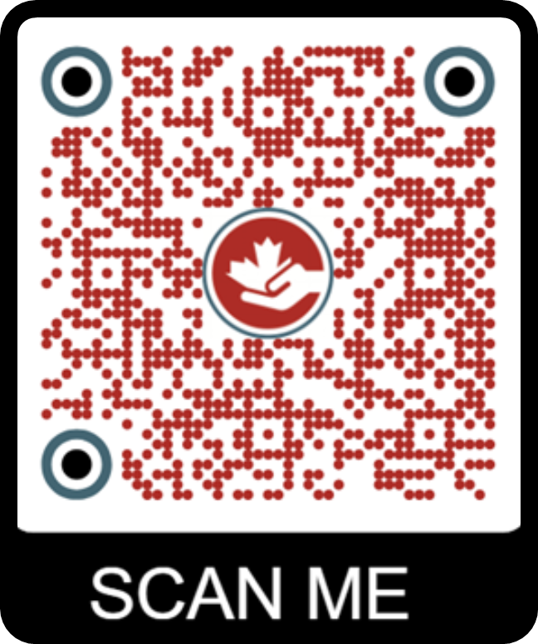

Want to know more about how to better reach cross-culturally right here in Canada? Check our recommended resources at:
(TO BE DEFINED, w QR link)
Is God calling YOU to cross-cultural outreach in Canada?
Mission Canada deploys those called of God as workers to be His witnesses in the gaps of Canada. Our five missional gaps in Canada are: Cultural, Urban, Indigenous, Francophone & Quebec, and NextGen (Campus, Youth and Children). To learn more about our missional work in Canada
and what it takes to become a deployed worker with Mission Canada, scan this QR
code. We look forward to engaging with you!
© PAOC MISSION CANADA, ALL RIGHTS RESERVED

Slide 13
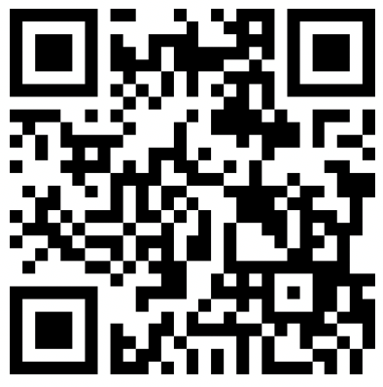
SIKHS
Will you make a
Kingdom investment
in this project and ministry?
Your gifts empower:
The national call to prayer, equip and deploy God’s people to reaching cross-culturally in Canada
The deployment of new cross-cultural workers in Canada
And the production of more materials like this to raise awareness, share vision, stimulate prayer, and equip God’s people
To invest, scan this QR code or visit:
www.paoc.org/canada/workers/nnnetworknational

